Slide 1
UNIT – II: Searching: Searching for solutions, uniformed search strategies – Breadth first search, depth limited Search. Search with partial information (Heuristic search) Greedy best first search, A* search,AO*, Memory -bounded heuristic search, Local search algorithms- Hill climbing, Simulated annealing search, Local beam search.

Slide 2
Search Algorithm Terminologies:
Search: Searching is a step by step procedure to solve a search-problem in a given search space.
A search problem can have three main factors:
Search Space: Search space represents a set of possible solutions, which a system may have.
Start State: It is a state from where agent begins the search.
Goal test: It is a function which observe the current state and returns whether the goal state is achieved or not.

Slide 3
Search Algorithm Terminologies
Search tree: A tree representation of search problem is called Search tree. The root of the search tree is the root node which is corresponding to the initial state.
Actions: It gives the description of all the available actions to the agent.
Transition model: A description of what each action do, can be represented as a transition model.
Path Cost: It is a function which assigns a numeric cost to each path.
Solution: It is an action sequence which leads from the start node to the goal
Optimal Solution: If a solution has the lowest cost among all solutions.

Slide 4
Properties of Search Algorithms:
Completeness: A search algorithm is said to be complete if it guarantees to return a solution if at least any solution exists for any random input.
Optimality: If a solution found for an algorithm is guaranteed to be the best solution (lowest path cost) among all other solutions, then such a solution for is said to be an optimal solution.
Time Complexity: Time complexity is a measure of time for an algorithm to complete its task.
Space Complexity: It is the maximum storage space required at any point during the search, as the complexity of the problem.

Slide 5
Types of search algorithms
uninformed (Blind search) search
The uninformed search does not contain any domain knowledge
It operates in a brute-force way as it only includes information about how to traverse the tree and how to identify leaf and goal nodes
Informed search (Heuristic search)
Informed search algorithms use domain knowledge.
problem information is available which can guide the search.
Informed search is also called a Heuristic search.

Slide 6
Types
Uninformed search is divided into
Breadth-first search
Uniform cost search
Depth-first search
Iterative deepening depth-first search
Bidirectional Search
Informed search
Greedy Search
A* ,AO*Search

Slide 7
Breadth-first Search:
Breadth-first search is the most common search strategy for traversing a tree or graph. This algorithm searches breadthwise in a tree or graph, so it is called breadth-first search.
BFS algorithm starts searching from the root node of the tree and expands all successor node at the current level before moving to nodes of next level.
The breadth-first search algorithm is an example of a general-graph search algorithm.
Breadth-first search implemented using FIFO queue data structure.

Slide 8
Advantages:
BFS will provide a solution if any solution exists.
If there is more than one solution for a given problem, then BFS will provide the minimal solution which requires the least number of steps.
Disadvantages:
It requires lots of memory since each level of the tree must be saved into memory to expand the next level.
BFS needs lots of time if the solution is far away from the root node.

Slide 9
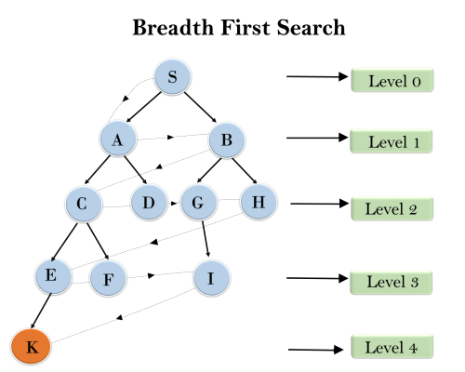
Example
S---> A--->B---->C--->D---->G--->H--->E---->F---->I---->K

Slide 10
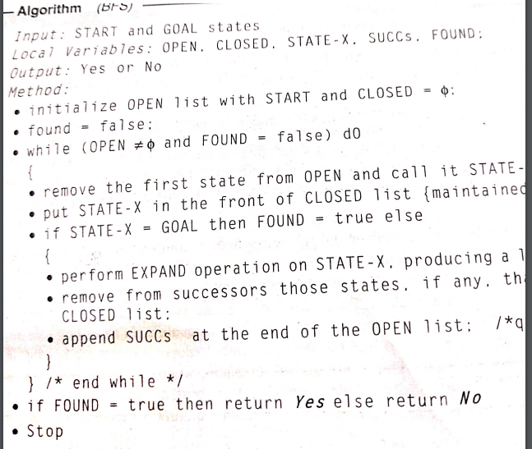

Slide 11
Depth-first Search
Depth-first search is a recursive algorithm for traversing a tree or graph data structure.
It is called the depth-first search because it starts from the root node and follows each path to its greatest depth node before moving to the next path.
DFS uses a stack data structure for its implementation.
The process of the DFS algorithm is similar to the BFS algorithm.

Slide 12
Example
In the below search tree, we have shown the flow of depth-first search, and it will follow the order as:
Root node--->Left node ----> right node.
It will start searching from root node S, and traverse A, then B, then D and E, after traversing E, it will backtrack the tree as E has no other successor and still goal node is not found. After backtracking it will traverse node C and then G, and here it will terminate as it found goal node.

Slide 13
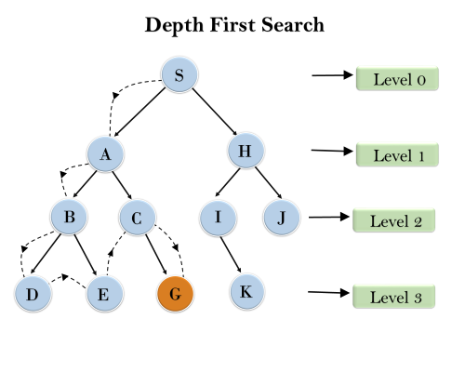

Slide 14
Depth-first Search
Completeness: DFS search algorithm is complete within finite state space as it will expand every node within a limited search tree.
Time Complexity: Time complexity of DFS will be equivalent to the node traversed by the algorithm. It is given by:
T(n)= 1+ n²+ n³ +.........+ n^{m}=O(n^{m})
Where, m= maximum depth of any node and this can be much larger than d (Shallowest solution depth)
Space Complexity: DFS algorithm needs to store only single path from the root node, hence space complexity of DFS is equivalent to the size of the fringe set, which is O(bm).
Optimal: DFS search algorithm is non-optimal, as it may generate a large number of steps or high cost to reach to the goal node.

Slide 15
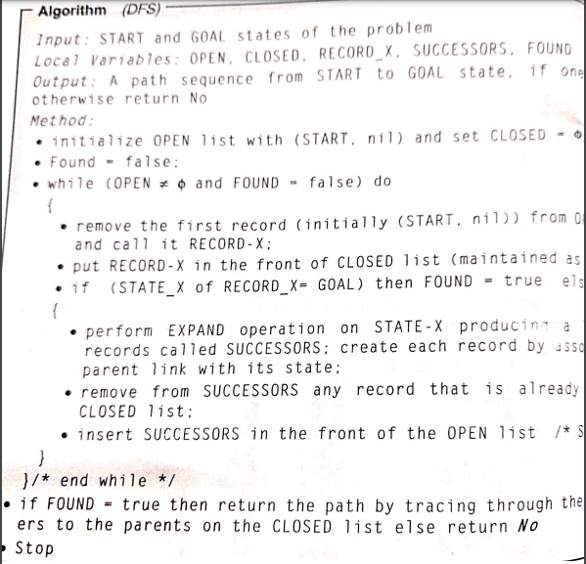
open

Slide 16
Properties of Breadth-first search
Time Complexity: Time Complexity of BFS algorithm can be obtained by the number of nodes traversed in BFS until the shallowest Node. Where the d= depth of shallowest solution and b is a node at every state.
T (b) = 1+b²+b³+.......+ b^{d}= O (b^{d})
Space Complexity: Space complexity of BFS algorithm is given by the Memory size of frontier which is O(b^{d}).
Completeness: BFS is complete, which means if the shallowest goal node is at some finite depth, then BFS will find a solution.
Optimality: BFS is optimal if path cost is a non-decreasing function of the depth of the node.
1 March 2025
16

Slide 17
Depth-first Search
Advantage:
DFS requires very less memory as it only needs to store a stack of the nodes on the path from root node to the current node.
It takes less time to reach to the goal node than BFS algorithm (if it traverses in the right path).
Disadvantage:
There is the possibility that many states keep re-occurring, and there is no guarantee of finding the solution.
DFS algorithm goes for deep down searching and sometime it may go to the infinite loop.

Slide 18
Depth-Limited Search Algorithm:
A depth-limited search algorithm is similar to depth-first search with a predetermined limit.
Depth-limited search can solve the drawback of the infinite path in the Depth-first search.
In this algorithm, the node at the depth limit will treat as it has no successor nodes further.
Depth-limited search can be terminated with two Conditions of failure:
Standard failure value: It indicates that problem does not have any solution.
Cutoff failure value: It defines no solution for the problem within a given depth limit.

Slide 19
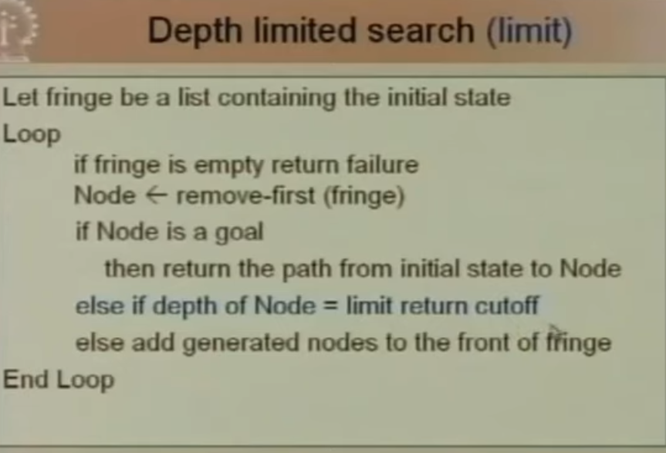

Slide 20
Depth-Limited Search Algorithm:
Advantages:
Depth-limited search is Memory efficient.
Disadvantages:
Depth-limited search also has a disadvantage of incompleteness.
It may not be optimal if the problem has more than one solution.

Slide 21
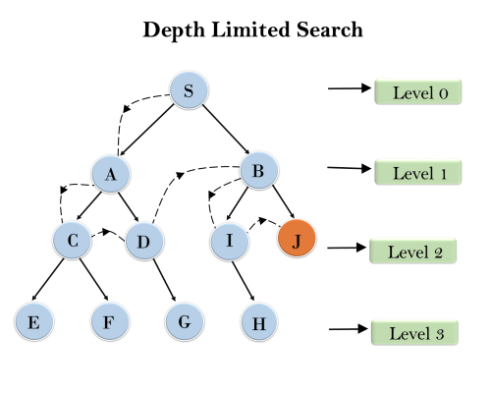

Slide 22
Depth-Limited Search Algorithm:
Completeness: DLS search algorithm is complete if the solution is above the depth-limit.
Time Complexity: Time complexity of DLS algorithm is O(b^{ℓ}).
Space Complexity: Space complexity of DLS algorithm is O(b×ℓ).
Optimal: Depth-limited search can be viewed as a special case of DFS, and it is also not optimal even if ℓ>d.

Slide 23
Uniform-cost Search Algorithm:
Uniform-cost search is a searching algorithm used for traversing a weighted tree or graph.
This algorithm comes into play when a different cost is available for each edge.
The primary goal of the uniform-cost search is to find a path to the goal node which has the lowest cumulative cost.
Uniform-cost search expands nodes according to their path costs from the root node.
It can be used to solve any graph/tree where the optimal cost is in demand.
A uniform-cost search algorithm is implemented by the priority queue.
It gives maximum priority to the lowest cumulative cost.
uniform cost search is equivalent to BFS algorithm if the path cost of all edges is the same.

Slide 24
Uniform-cost Search Algorithm:
Advantages:
Uniform cost search is optimal because at every state the path with the least cost is chosen.
Disadvantages:
It does not care about the number of steps involve in searching and only concerned about path cost. Due to which this algorithm may be stuck in an infinite loop.

Slide 25
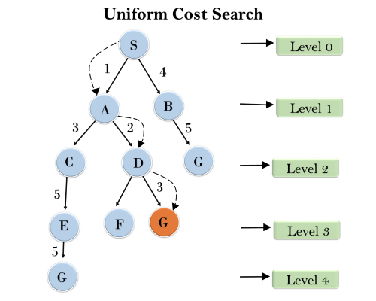

Slide 26
Completeness:
Uniform-cost search is complete, such as if there is a solution, UCS will find it.
Time Complexity:
Let C* is Cost of the optimal solution, and ε is each step to get closer to the goal node. Then the number of steps is = C*/ε+1. Here we have taken +1, as we start from state 0 and end to C*/ε.
Hence, the worst-case time complexity of Uniform-cost search isO(b^{1 + [C*/ε]})/.
Space Complexity:
The same logic is for space complexity so, the worst-case space complexity of Uniform-cost search is O(b^{1 + [C*/ε]}).
Optimal:
Uniform-cost search is always optimal as it only selects a path with the lowest path cost.

Slide 27
Iterative deepening depth-first Search:
The iterative deepening algorithm is a combination of DFS and BFS algorithms. This search algorithm finds out the best depth limit and does it by gradually increasing the limit until a goal is found.
This algorithm performs depth-first search up to a certain "depth limit", and it keeps increasing the depth limit after each iteration until the goal node is found.
This Search algorithm combines the benefits of Breadth-first search's fast search and depth-first search's memory efficiency.
The iterative search algorithm is useful uninformed search when search space is large, and depth of goal node is unknown.

Slide 28
Iterative deepening depth-first Search
Advantages:
It combines the benefits of BFS and DFS search algorithm in terms of fast search and memory efficiency.
Disadvantages:
The main drawback of IDDFS is that it repeats all the work of the previous phase.

Slide 29
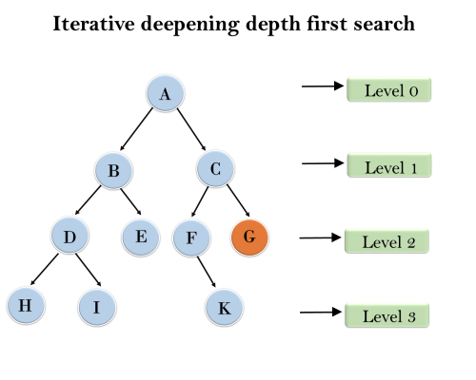
1'st Iteration-----> A 2'nd Iteration----> A, B, C 3'rd Iteration------>A, B, D, E, C, F, G 4'th Iteration------>A, B, D, H, I, E, C, F, K, G In the fourth iteration, the algorithm will find the goal node.

Slide 30
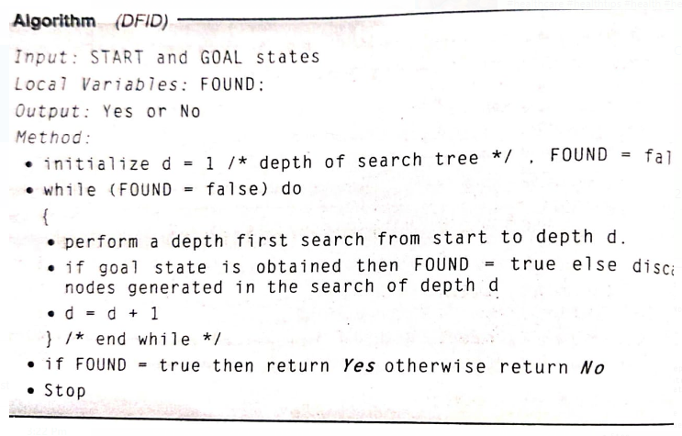

Slide 31
Iterative deepening depth-first Search
Completeness:
This algorithm is complete is if the branching factor is finite.
Time Complexity:
Let's suppose b is the branching factor and depth is d then the worst-case time complexity is O(b^{d}).
Space Complexity:
The space complexity of IDDFS will be O(bd).
Optimal:
IDDFS algorithm is optimal if path cost is a non- decreasing function of the depth of the node.

Slide 32
Bidirectional Search Algorithm:
Bidirectional search algorithm runs two simultaneous searches, one from initial state called as forward-search and other from goal node called as backward-search, to find the goal node.
Bidirectional search replaces one single search graph with two small subgraphs in which one starts the search from an initial vertex and other starts from goal vertex.
The search stops when these two graphs intersect each other.
Bidirectional search can use search techniques such as BFS, DFS, DLS, etc.

Slide 33
Bidirectional Search Algorithm
Advantages:
Bidirectional search is fast.
Bidirectional search requires less memory
Disadvantages:
Implementation of the bidirectional search tree is difficult.
In bidirectional search, one should know the goal state in advance.

Slide 34
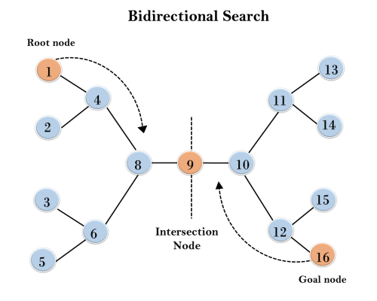
This algorithm divides one graph/tree into two sub-graphs. It starts traversing from node 1 in the forward direction and starts from goal node 16 in the backward direction.
The algorithm terminates at node 9 where two searches meet.

Slide 35
Bidirectional Search Algorithm
Completeness: Bidirectional Search is complete if we use BFS in both searches.
Time Complexity: Time complexity of bidirectional search using BFS is O(b^{d}).
Space Complexity: Space complexity of bidirectional search is O(b^{d}).
Optimal: Bidirectional search is Optimal.

Slide 36
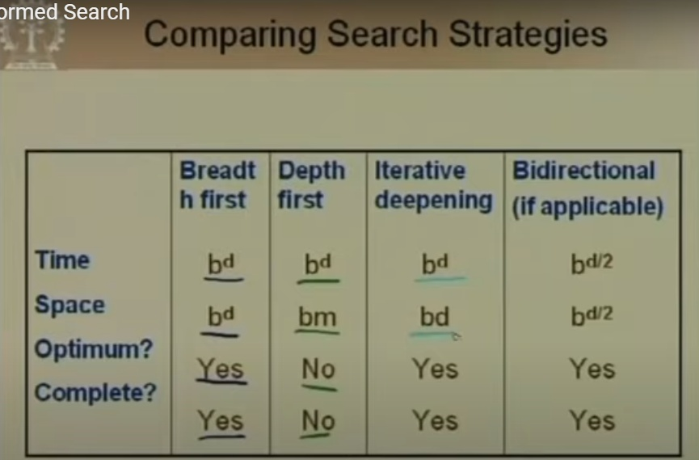

Slide 37
Informed Search Algorithms
informed search algorithm contains an array of knowledge such as how far we are from the goal, path cost, how to reach to goal node.
This knowledge help agents to explore less to the search space and find more efficiently the goal node.
Informed search algorithm uses the idea of heuristic function.
Heuristic function :It takes the current state of the agent as its input and produces the estimation of how close agent is from the goal.
The heuristic method, however, might not always give the best solution, but it guaranteed to find a good solution in reasonable time.

Slide 38
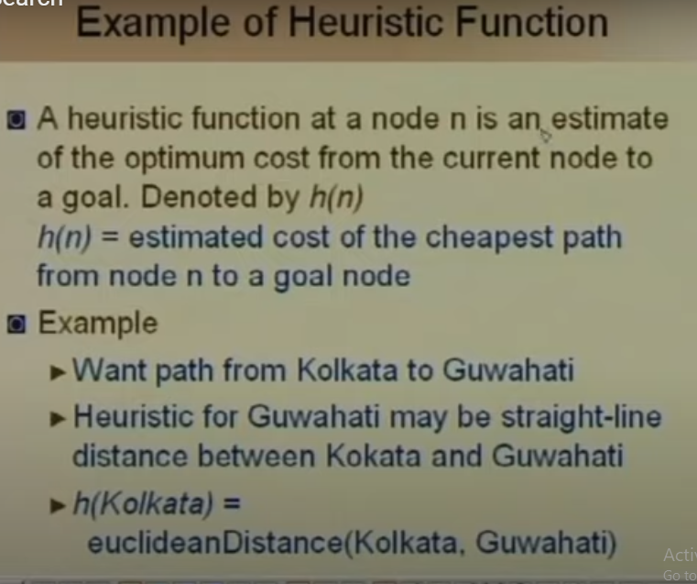

Slide 39
Informed Search Algorithms
Admissibility of the heuristic function is given as:
h(n) <= h*(n)
Here h(n) is heuristic cost, and h*(n) is the estimated cost.
Hence heuristic cost should be less than or equal to the estimated cost.

Slide 40
Heuristic search
Heuristic search is the simplest form of heuristic search algorithms.
It expands nodes based on their heuristic value h(n).
It maintains two lists, OPEN and CLOSED list.
In the CLOSED list, it places those nodes which have already expanded and in the OPEN list, it places nodes which have yet not been expanded.
On each iteration, each node n with the lowest heuristic value is expanded and generates all its successors and n is placed to the closed list.
The algorithm continues unit a goal state is found.

Slide 41
Informed Search Algorithms
Best First Search Algorithm(Greedy search)
A* Search Algorithm

Slide 42
Best First Search Algorithm(Greedy search)
Greedy best-first search algorithm always selects the path which appears best at that moment.
It is the combination of depth-first search and breadth-first search algorithms.
It uses the heuristic function and search.
Best-first search allows us to take the advantages of both algorithms.
At each step, we can choose the most promising node.
In the best first search algorithm, we expand the node which is closest to the goal node and the closest cost is estimated by heuristic function,

Slide 43
Best first search algorithm:
Step 1: Place the starting node into the OPEN list.
Step 2: If the OPEN list is empty, Stop and return failure.
Step 3: Remove the node n, from the OPEN list which has the lowest value of h(n), and places it in the CLOSED list.
Step 4: Expand the node n, and generate the successors of node n.
Step 5: Check each successor of node n, and find whether any node is a goal node or not. If any successor node is goal node, then return success and terminate the search, else proceed to Step 6.
Step 6: For each successor node, algorithm checks for evaluation function f(n), and then check if the node has been in either OPEN or CLOSED list. If the node has not been in both list, then add it to the OPEN list.
Step 7: Return to Step 2.

Slide 44
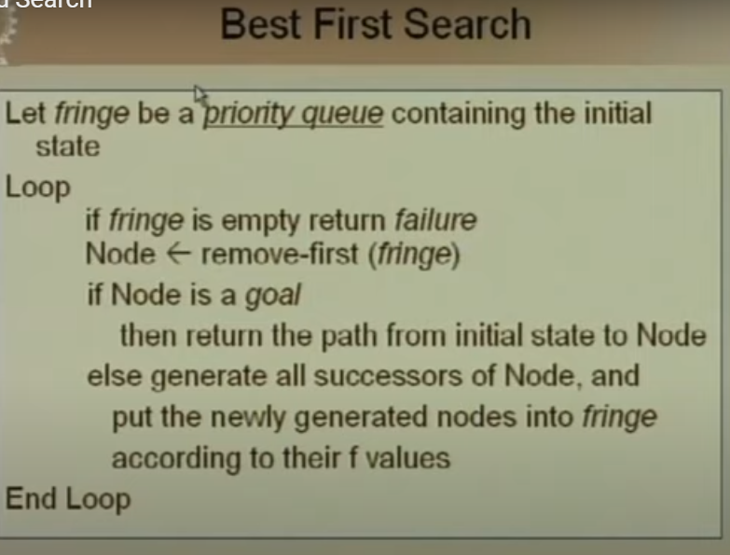

Slide 45
Advantages:
Best first search can switch between BFS and DFS by gaining the advantages of both the algorithms.
This algorithm is more efficient than BFS and DFS algorithms.
Disadvantages:
It can behave as an unguided depth-first search in the worst case scenario.
It can get stuck in a loop as DFS.
This algorithm is not optimal.

Slide 46
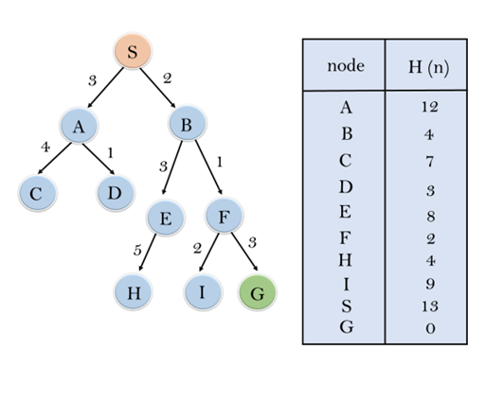

Slide 47
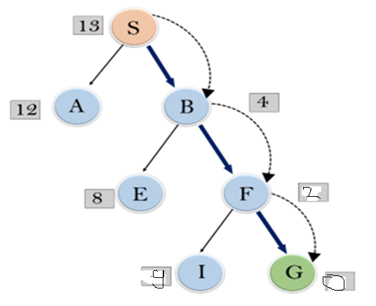

Slide 48
Expand the nodes of S and put in the CLOSED list
Initialization: Open [A, B], Closed [S]
Iteration 1: Open [A], Closed [S, B]
Iteration 2: Open [E, F, A], Closed [S, B] : Open [E, A], Closed [S, B, F]
Iteration 3: Open [I, G, E, A], Closed [S, B, F] : Open [I, E, A], Closed [S, B, F, G]
Hence the final solution path will be:
S----> B----->F----> G

Slide 49
Time Complexity: The worst case time complexity of Greedy best first search is O(b^{m}).
Space Complexity: The worst case space complexity of Greedy best first search is O(b^{m}). Where, m is the maximum depth of the search space.
Complete: Greedy best-first search is also incomplete, even if the given state space is finite.
Optimal: Greedy best first search algorithm is not optimal.

Slide 50
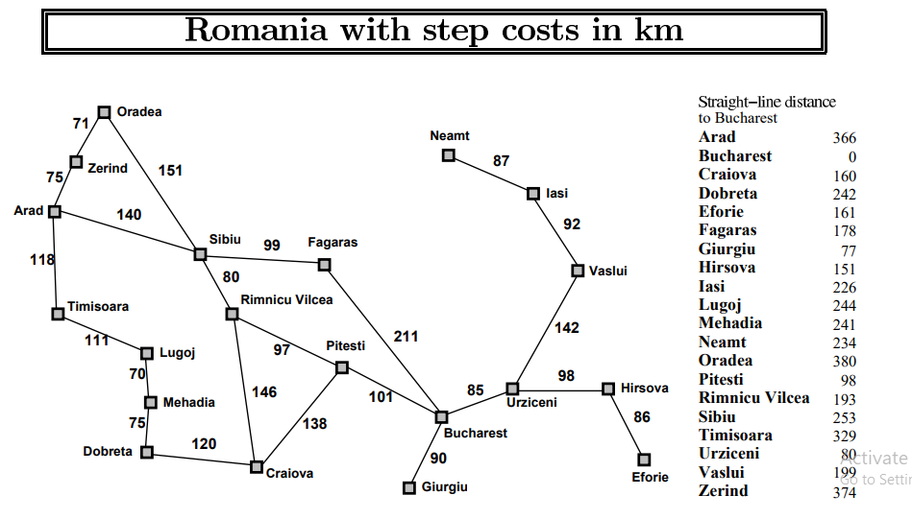

Slide 51
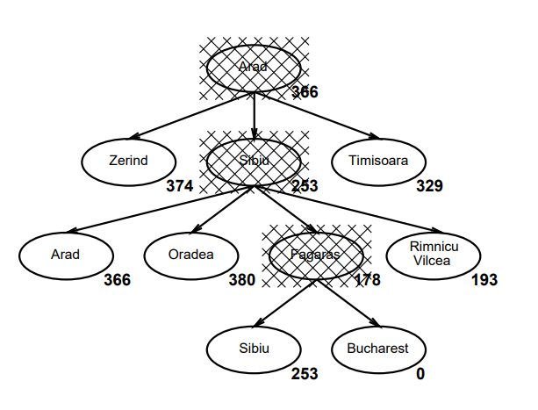

Slide 52
A* Search Algorithm:
A* search is the most commonly known form of best-first search.
It uses heuristic function h(n), and cost to reach the node n from the start state g(n).
It has combined features of UCS and greedy best-first search, by which it solve the problem efficiently
This search algorithm expands less search tree and provides optimal result faster.
A* algorithm is similar to UCS except that it uses g(n)+h(n) instead of g(n).

Slide 53
A* Search Algorithm:
Step1: Place the starting node in the OPEN list.
Step 2: Check if the OPEN list is empty or not, if the list is empty then return failure and stops.
Step 3: Select the node from the OPEN list which has the smallest value of evaluation function (g+h), if node n is goal node then return success and stop, otherwise
Step 4: Expand node n and generate all of its successors, and put n into the closed list. For each successor n', check whether n' is already in the OPEN or CLOSED list, if not then compute evaluation function for n' and place into Open list.
Step 5: Else if node n' is already in OPEN and CLOSED, then it should be attached to the back pointer which reflects the lowest g(n') value.
Step 6: Return to Step 2.

Slide 54
Advantages:
A* search algorithm is the best algorithm than other search algorithms.
A* search algorithm is optimal and complete.
This algorithm can solve very complex problems.
Disadvantages:
It does not always produce the shortest path as it mostly based on heuristics and approximation.
A* search algorithm has some complexity issues.
The main drawback of A* is memory requirement as it keeps all generated nodes in the memory, so it is not practical for various large-scale problems.

Slide 55
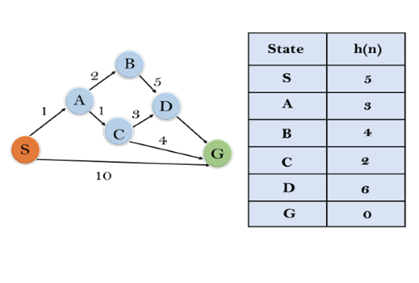
Example

Slide 56
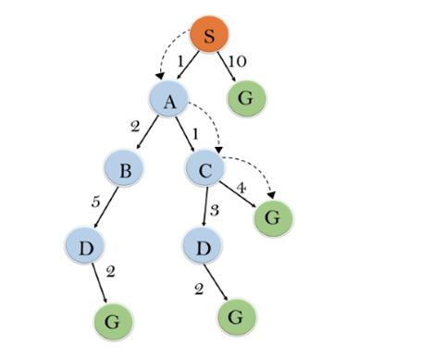
A* Search Algorithm:

Slide 57
A* Search Algorithm:
Initialization: {(S, 5)}
Iteration1: {(S--> A, 4), (S-->G, 10)}
Iteration2: {(S--> A-->C, 4), (S--> A-->B, 7), (S-->G, 10)}
Iteration3: {(S--> A-->C--->G, 6), (S--> A-->C--->D, 11), (S--> A-->B, 7), (S-->G, 10)}
Iteration 4 will give the final result, as S--->A--->C--->G it provides the optimal path with cost 6.

Slide 58
A* Search Algorithm:
Complete: A* algorithm is complete as long as:
Branching factor is finite.
Cost at every action is fixed.
Optimal: A* search algorithm is optimal if it follows below two conditions:
Admissible: the first condition requires for optimality is that h(n) should be an admissible heuristic for A* tree search. An admissible heuristic is optimistic in nature.
Consistency: Second required condition is consistency for only A* graph-search.
If the heuristic function is admissible, then A* tree search will always find the least cost path.
Time Complexity: The time complexity of A* search algorithm depends on heuristic function, and the number of nodes expanded is exponential to the depth of solution d. So the time complexity is O(b^d), where b is the branching factor.
Space Complexity: The space complexity of A* search algorithm is O(b^d)

Slide 59
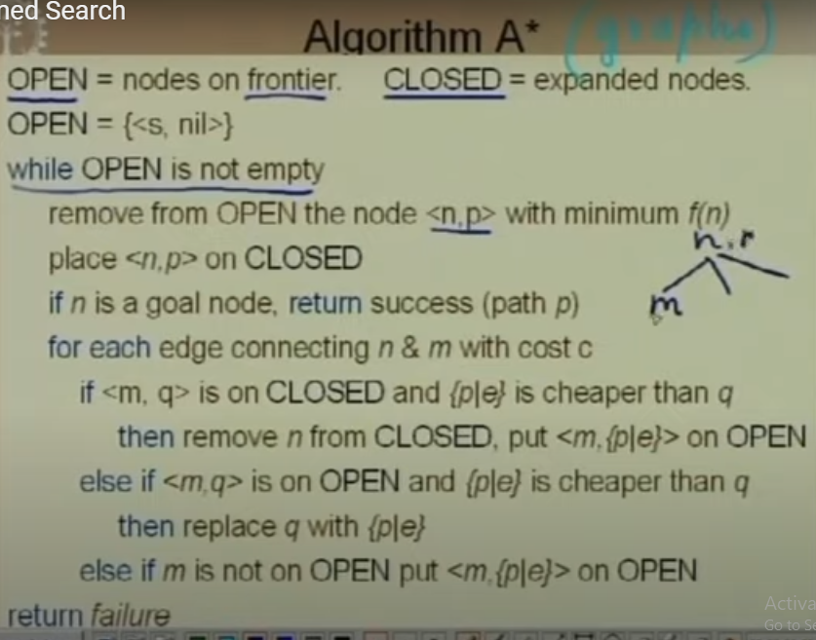

Slide 60
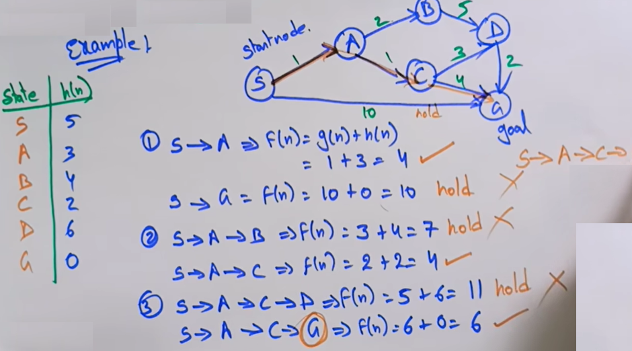

Slide 61
AO* algorithm
The AO algorithm* (short for “And-Or Star”) is a powerful best-first search method used to solve problems that can be represented as a directed acyclic graph (DAG). Unlike traditional algorithms like A*, which explore a single path, the AO* algorithm evaluates multiple paths simultaneously.
The AO* algorithm is based on AND-OR graphs to break complex problems into smaller ones and then solve them. The AND side of the graph represents those tasks that need to be done with each other to reach the goal, while the OR side stands alone for a single task.

Slide 63
Hill Climbing Algorithm
Hill climbing algorithm is a local search algorithm which continuously moves in the direction of increasing elevation/value to find the peak of the mountain or best solution to the problem.
It terminates when it reaches a peak value where no neighbor has a higher value.
Hill climbing algorithm is a technique which is used for optimizing the mathematical problems
It is also called greedy local search as it only looks to its good immediate neighbor state and not beyond that.
A node of hill climbing algorithm has two components which are state and value.

Slide 64
Features of Hill Climbing:
Generate and Test variant: Hill Climbing is the variant of Generate and Test method. The Generate and Test method produce feedback which helps to decide which direction to move in the search space.
Greedy approach: Hill-climbing algorithm search moves in the direction which optimizes the cost.
No backtracking: It does not backtrack the search space, as it does not remember the previous states.

Slide 65
Different regions in the state space landscape
Local Maximum: Local maximum is a state which is better than its neighbor states, but there is also another state which is higher than it.
Global Maximum: Global maximum is the best possible state of state space landscape. It has the highest value of objective function.
Current state: It is a state in a landscape diagram where an agent is currently present.
Flat local maximum: It is a flat space in the landscape where all the neighbor states of current states have the same value.
Shoulder: It is a plateau region which has an uphill edge.

Slide 66
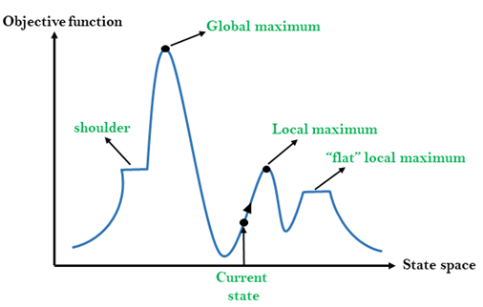
State-space Diagram
The state-space landscape is a graphical representation of the hill-climbing algorithm which is showing a graph between various states of algorithm and Objective function/Cost.

Slide 67
Types of Hill Climbing Algorithm:
Simple hill Climbing:
Steepest-Ascent hill-climbing:
Stochastic hill Climbing:
1. Simple Hill Climbing:
Simple hill climbing is the simplest way to implement a hill climbing algorithm.
It only evaluates the neighbor node state at a time and selects the first one which optimizes current cost and set it as a current state.
It only checks it's one successor state, and if it finds better than the current state, then move else be in the same state.
This algorithm has the following features:
Less time consuming
Less optimal solution and the solution is not guaranteed

Slide 68
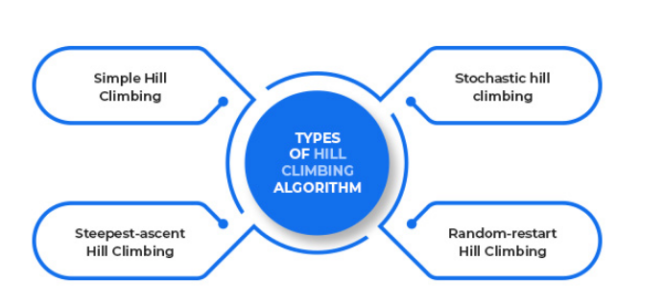
Types of Hill Climbing Algorithm:

Slide 69
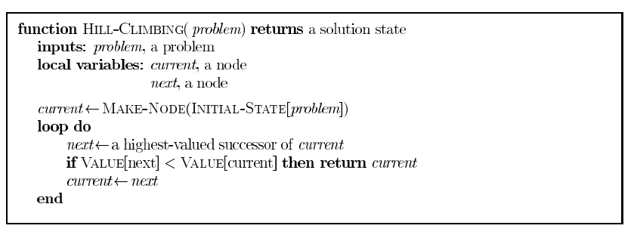

Slide 70
Algorithm for Simple Hill Climbing:
Step 1: Evaluate the initial state, if it is goal state then return success and Stop.
Step 2: Loop Until a solution is found or there is no new operator left to apply.
Step 3: Select and apply an operator to the current state.
Step 4: Check new state:
If it is goal state, then return success and quit.
Else if it is better than the current state then assign new state as a current state.
Else if not better than the current state, then return to step2.
Step 5: Exit.

Slide 71
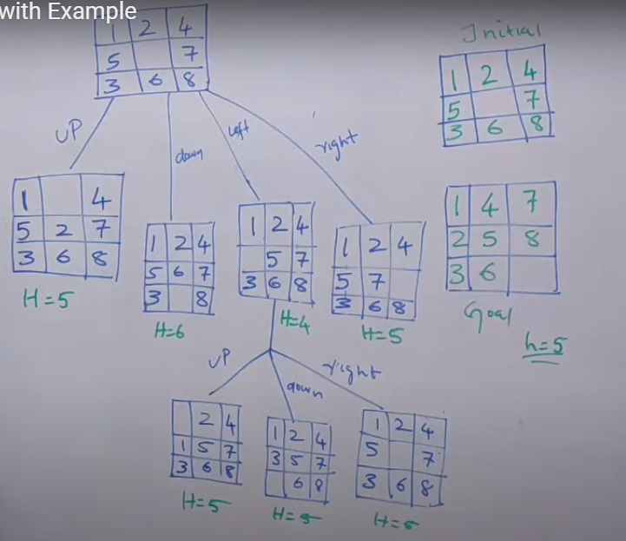
Example

Slide 72
2. Steepest-Ascent hill climbing:
The steepest-Ascent algorithm is a variation of simple hill climbing algorithm. This algorithm examines all the neighboring nodes of the current state and selects one neighbor node which is closest to the goal state. This algorithm consumes more time as it searches for multiple neighbors

Slide 73
Algorithm for Steepest-Ascent hill climbing:
Step 1: Evaluate the initial state, if it is goal state then return success and stop, else make current state as initial state.
Step 2: Loop until a solution is found or the current state does not change.
Let SUCC be a state such that any successor of the current state will be better than it.
For each operator that applies to the current state:
Apply the new operator and generate a new state.
Evaluate the new state.
If it is goal state, then return it and quit, else compare it to the SUCC.
If it is better than SUCC, then set new state as SUCC.
If the SUCC is better than the current state, then set current state to SUCC.
Step 5: Exit.

Slide 74
3. Stochastic hill climbing:
Stochastic hill climbing does not examine for all its neighbor before moving. Rather, this search algorithm selects one neighbor node at random and decides whether to choose it as a current state or examine another state.

Slide 75
Problems in Hill Climbing Algorithm:
1. Local Maximum: A local maximum is a peak state in the landscape which is better than each of its neighboring states, but there is another state also present which is higher than the local maximum.
Solution: Backtracking technique can be a solution of the local maximum in state space landscape. Create a list of the promising path so that the algorithm can backtrack the search space and explore other paths as well.

Slide 76
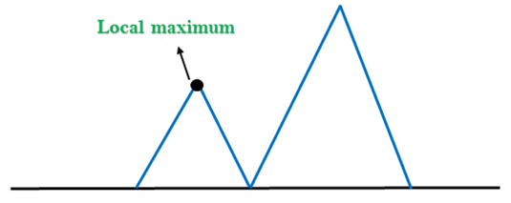
Local Maximum

Slide 77
Problems in Hill Climbing Algorithm:
2. Plateau: A plateau is the flat area of the search space in which all the neighbor states of the current state contains the same value, because of this algorithm does not find any best direction to move. A hill-climbing search might be lost in the plateau area.
Solution: The solution for the plateau is to take big steps or very little steps while searching, to solve the problem. Randomly select a state which is far away from the current state so it is possible that the algorithm could find non-plateau region.

Slide 78
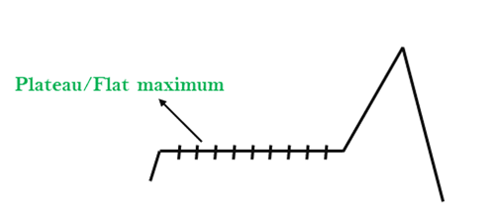
Plateau:

Slide 79
Problems in Hill Climbing Algorithm:
3. Ridges: A ridge is a special form of the local maximum. It has an area which is higher than its surrounding areas, but itself has a slope, and cannot be reached in a single move.
Solution: With the use of bidirectional search, or by moving in different directions, we can improve this problem.

Slide 80
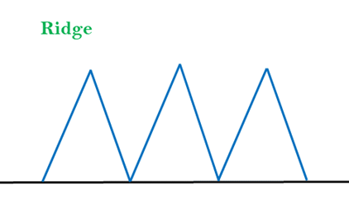
Ridges

Slide 81
Applications of hill climbing algorithm
The hill-climbing algorithm can be applied in the following areas:
Marketing
A hill-climbing algorithm can help a marketing manager to develop the best marketing plans. establish the local minima efficiently.
Robotics
Hill climbing is useful in the effective operation of robotics. It enhances the coordination of different systems and components in robots.
Job Scheduling
The hill climbing algorithm has also been applied in job scheduling.
One of the most popular examples of a hill-climbing algorithm is the traveling salesman.

Slide 82
Simulated Annealing algorithm
The Simulated Annealing algorithm is based upon Physical Annealing in real life.
Physical Annealing is the process of heating up a material until it reaches an annealing temperature and then it will be cooled down slowly in order to change the material to a desired structure.
When the material is hot, the molecular structure is weaker and is more susceptible to change. When the material cools down, the molecular structure is harder and is less susceptible to change.

Slide 83
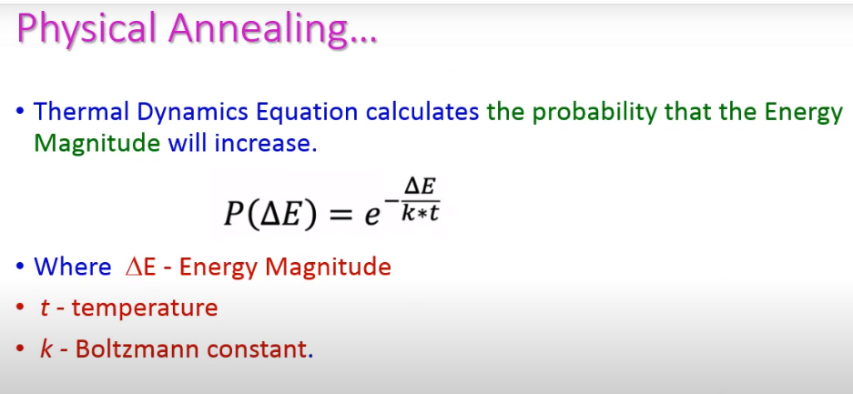

Slide 84
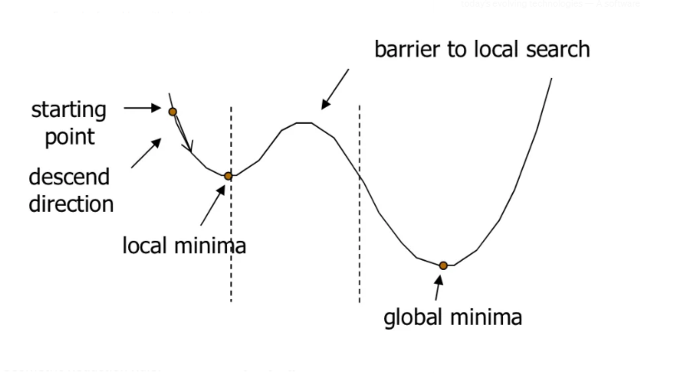
Simulated Annealing
It is used for optimizing parameters in a model.
This process is very useful for situations where there are a lot of local minima.
Gradient Descent Algorithm would be stuck at local minima and not be able to reach the global minima.

Slide 85
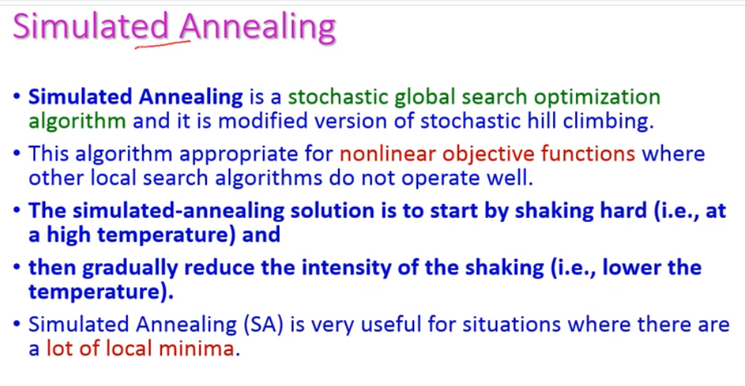

Slide 86
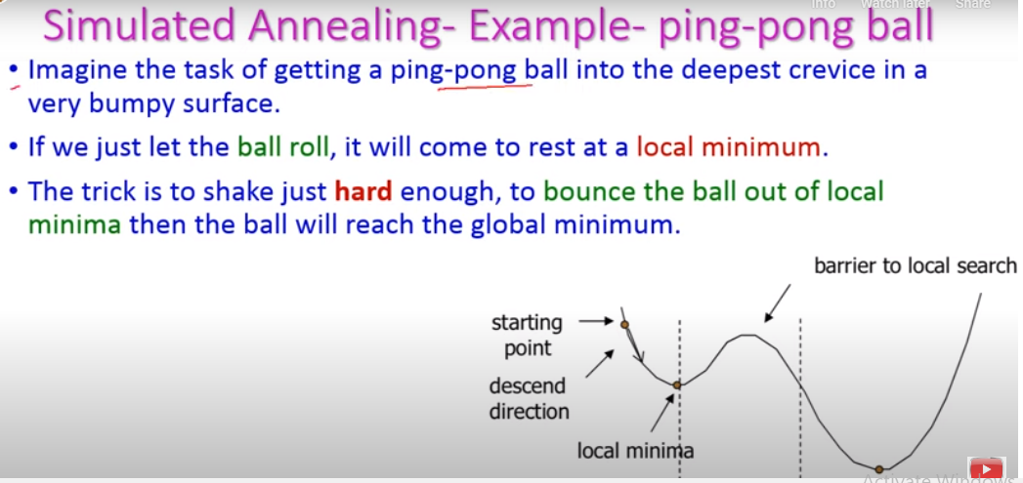

Slide 87
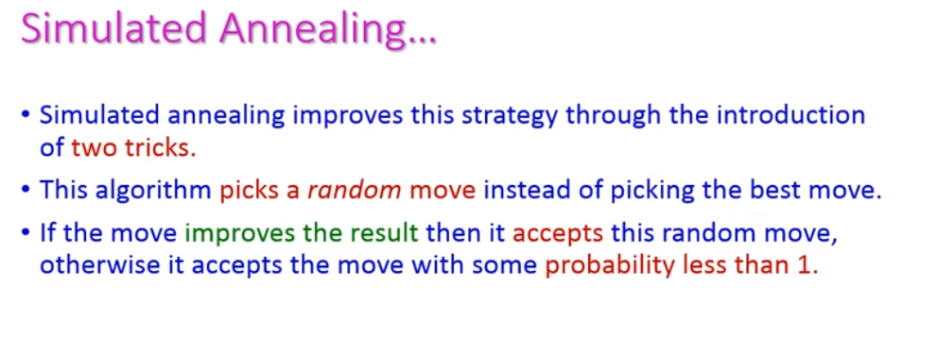

Slide 88
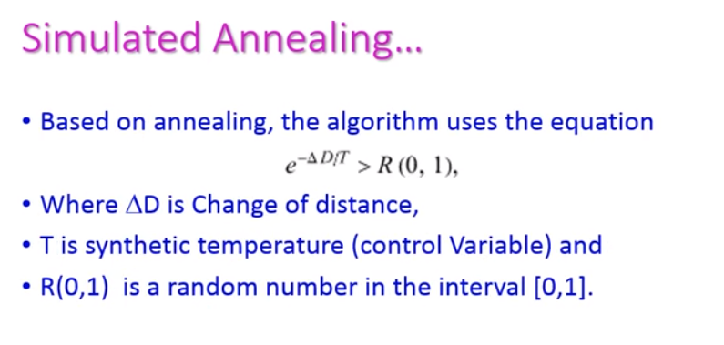

Slide 89
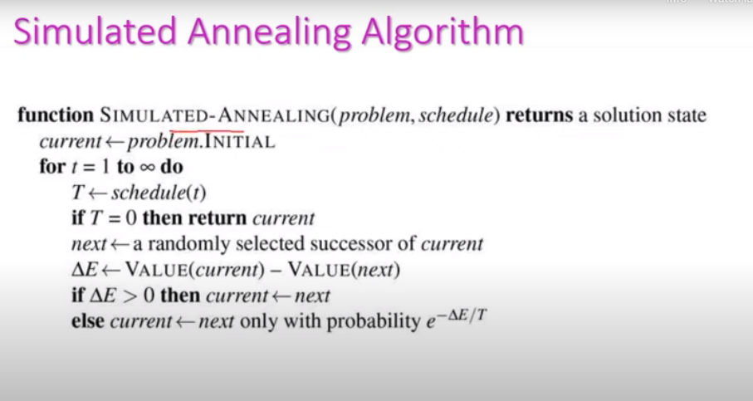

Slide 90
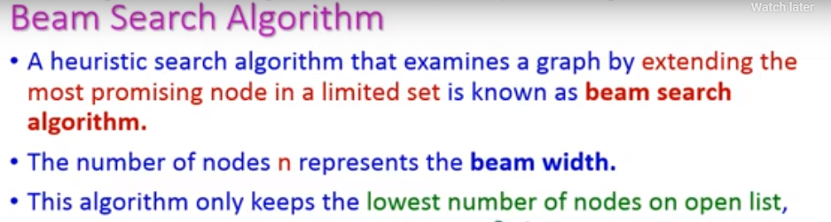
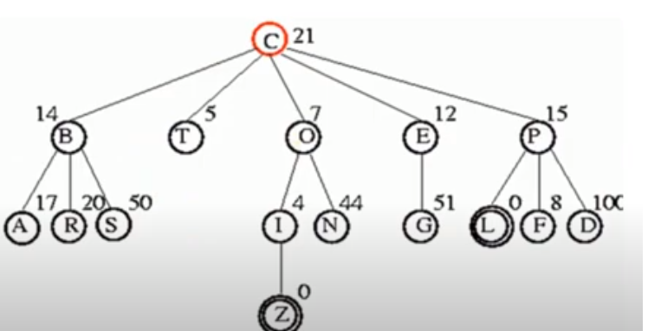
Beam Search algorithm

Slide 91
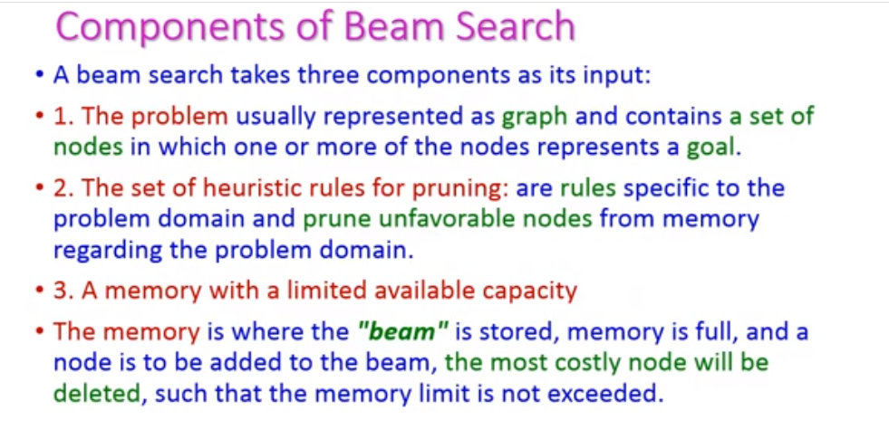

Slide 92
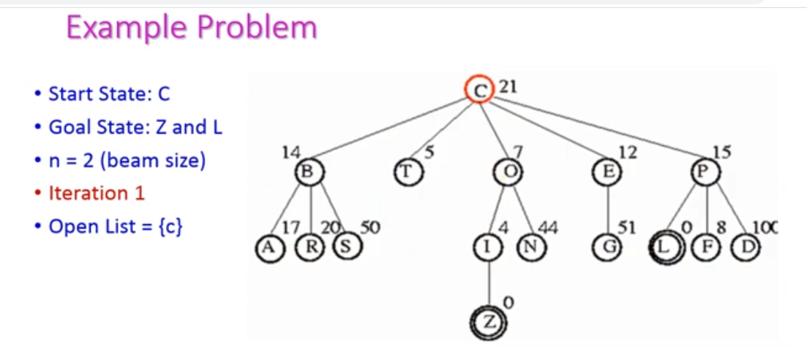

Slide 93
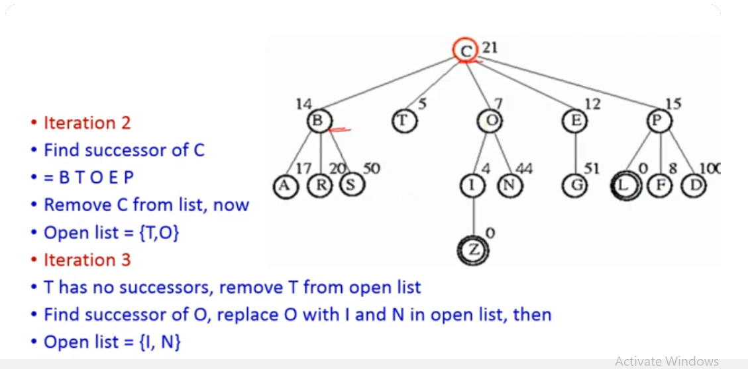

Slide 94
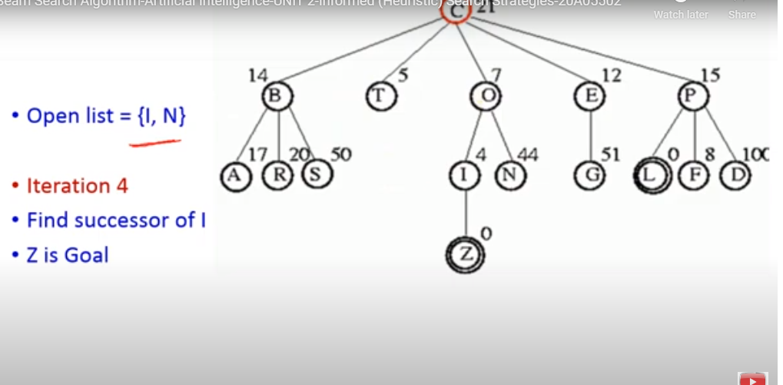

Slide 95
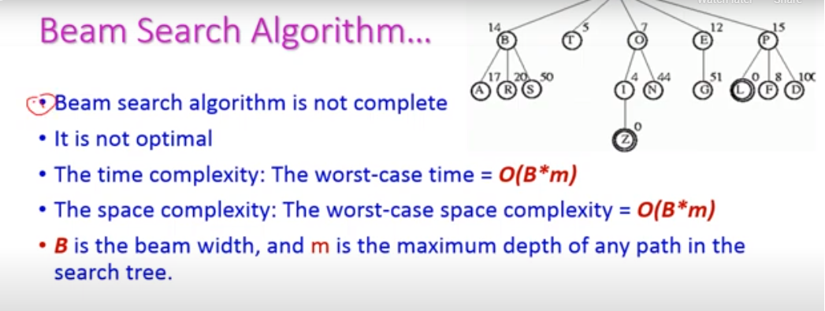

Slide 96
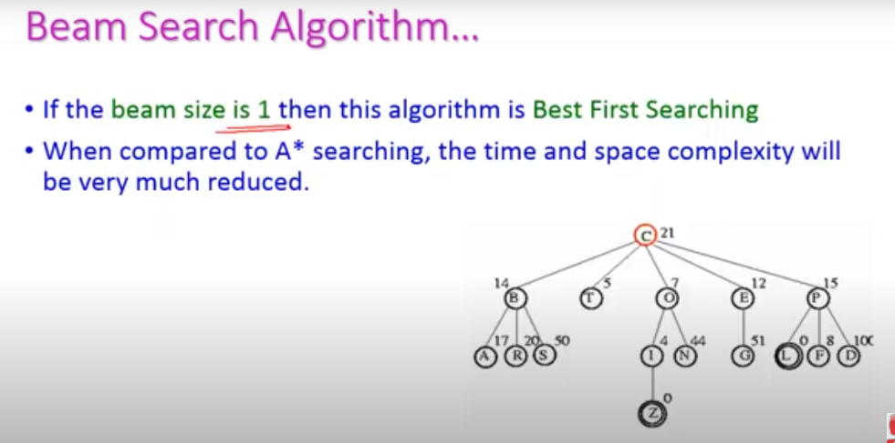

Slide 97
Stochastic beam search
Stochastic beam search is an alternative to beam search, which, instead of choosing the best k individuals, selects k of the individuals at random; the individuals with a better evaluation are more likely to be chosen.
This is done by making the probability of being chosen a function of the evaluation function.

Slide 98


